Slide 1

The Natural Language Processing of Humor
Roy Kim
Notes:
What do you get when you cross a pirate and a little butter? A bathroom.

Slide 2
Background Information
"Reddit is an American social news aggregation, web content rating, and discussion website.” (Wikipedia)
"Natural language processing (NLP) is a subfield of computer science, information engineering, and artificial intelligence concerned with the interactions between computers and human (natural) languages.” (Wikipedia)
Humor is one of the most nuanced and difficult aspects to understand of human language.
Notes:
Reddit is a trove of information and data on a plethora of subjects, grouped in what are called "subreddits."

Slide 3
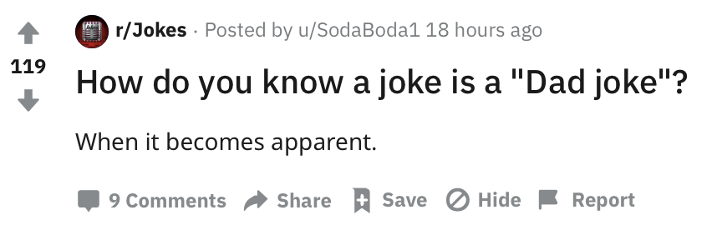
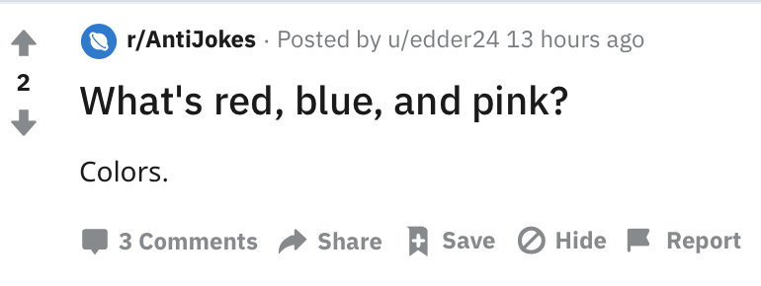
Joke vs. AntiJoke

Slide 4
Goal
Use the Reddit API to extract and analyze the text from two subreddits (/r/Jokes and /r/AntiJokes).
Use a variety of NLP and classification techniques to preprocess data.
Build a model to accurately predict what subreddit a post is from.
Get a glimpse into how machine learning applies itself to humor.
Problem Statement
Using NLP and Classification techniques, can a model be created that predicts that a post belongs to the /r/AntiJokes subreddit correctly with greater accuracy than the baseline of 50%?

Slide 5

Approach
Using the Reddit API, extract data observations from /r/Jokes and /r/AntiJokes subreddits
Clean the extracted data (escape chars)
Use NLP techniques to preprocess the data and perform EDA
Use Latent Semantic Analysis to understand the relationship drawn between words by machine learning
Create classification models (Random Forests and Gradient Boosting)
Evaluate performance of models and answer problem statement

Slide 6
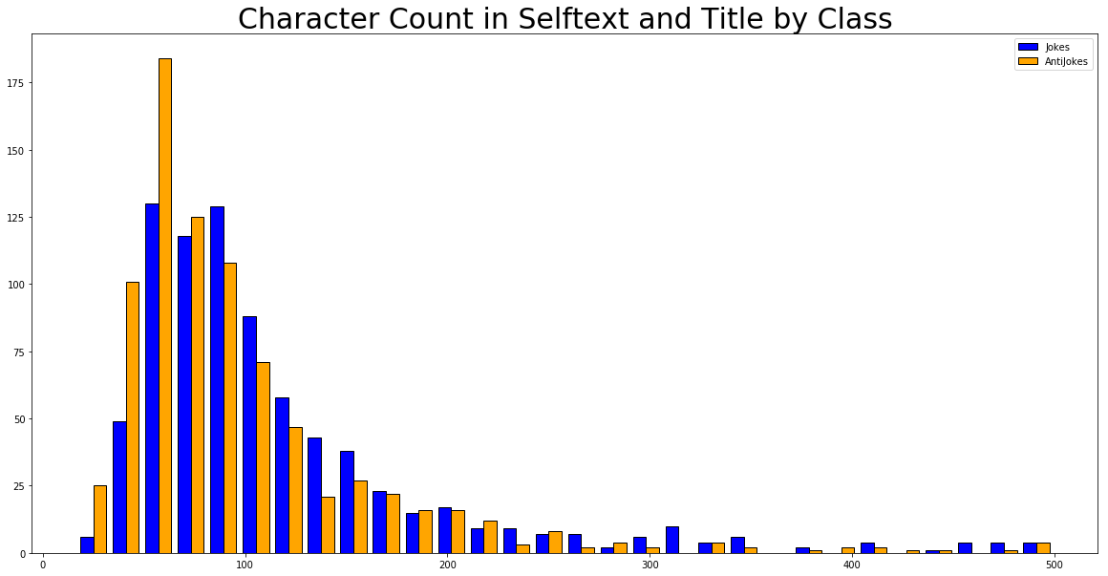
Step 1 Findings / Distribution of Character Count by Class

Slide 7
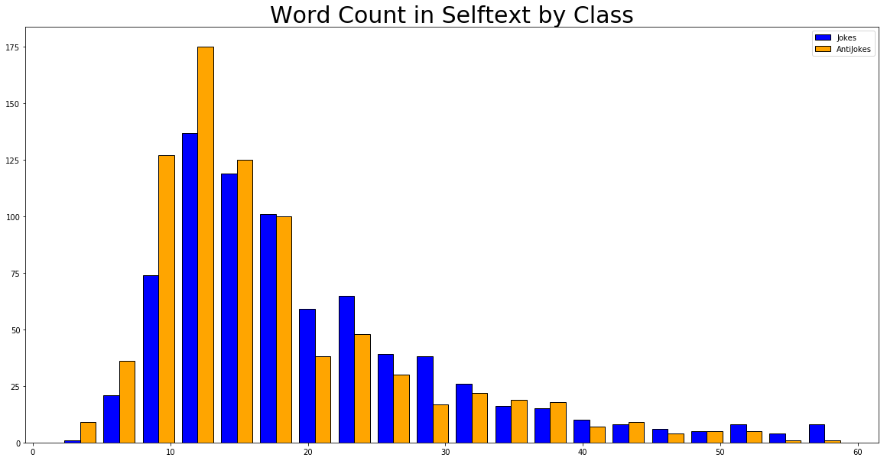
Step 1 Findings / Distribution of Word Count by Class

Slide 8
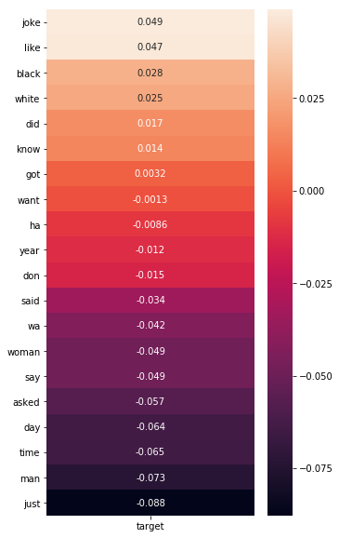
Step 2 Findings / Correlation of Top 20 Most Common Words

Slide 9
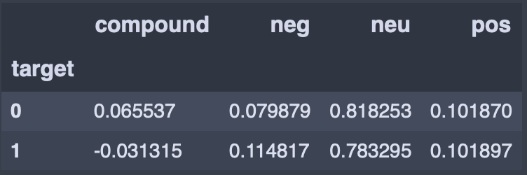
Step 3 Findings / Sentiment Analysis
VADER (Valence Aware Dictionary and sEntiment Reasoner) Sentiment Analysis by class
Slightly more negative for class 1 (/r/AntiJokes)
Slightly more neutral for class 0 (/r/Jokes)

Slide 10
Step 3 Findings / Sentiment Analysis
VADER (Valence Aware Dictionary and sEntiment Reasoner) Sentiment Analysis by class
Slightly more negative for class 1 (/r/AntiJokes)
Slightly more neutral for class 0 (/r/Jokes)

Slide 11
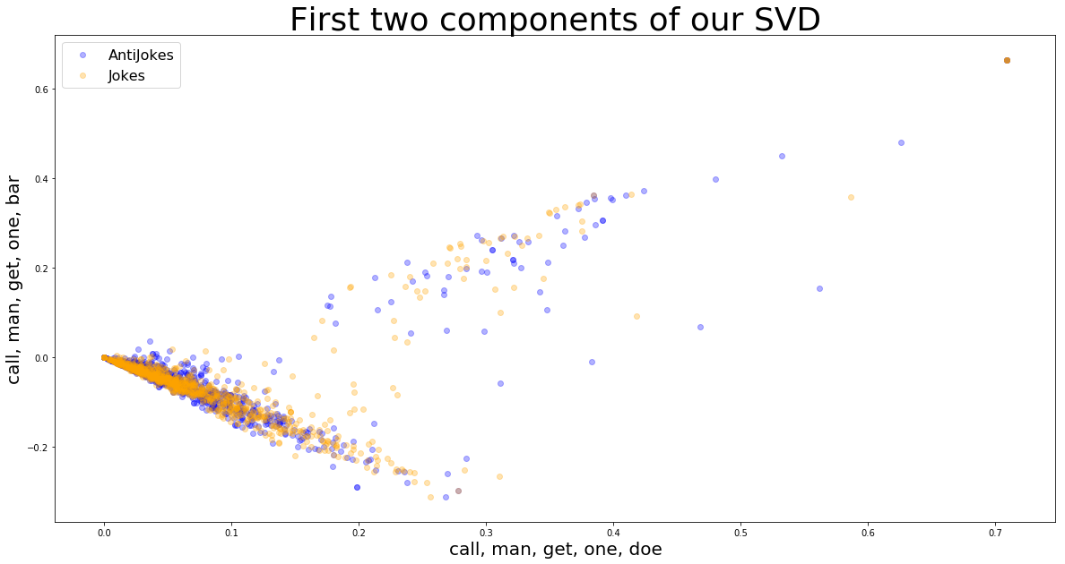
Step 4 Findings / Latent Semantic Analysis
Singular Value Decomposition (SVD): 1018 features from TFIDF ➔ 346 principal components (“topics”)
Graph of first two components, though not much classification occurring here
Notes:
Latent semantic analysis (LSA) is a technique in natural language processing of analyzing relationships between a set of documents and the terms they contain by producing a set of concepts related to the documents and terms.

Slide 12
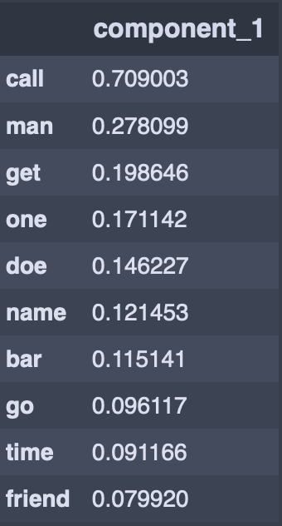
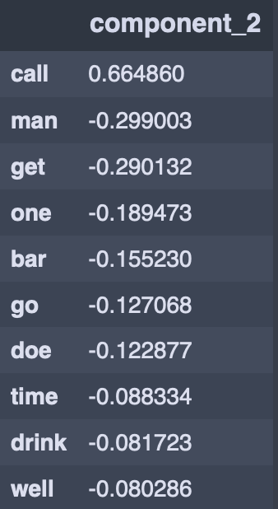
Step 4 Findings / Latent Semantic Analysis

Slide 13
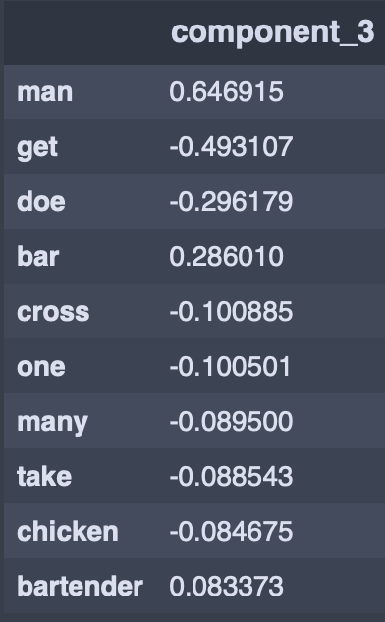
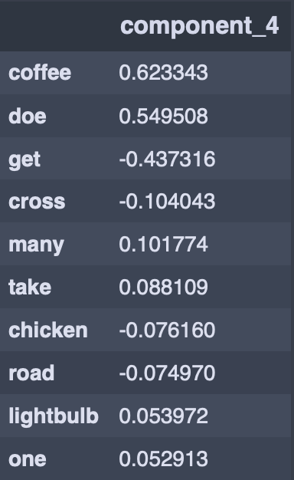
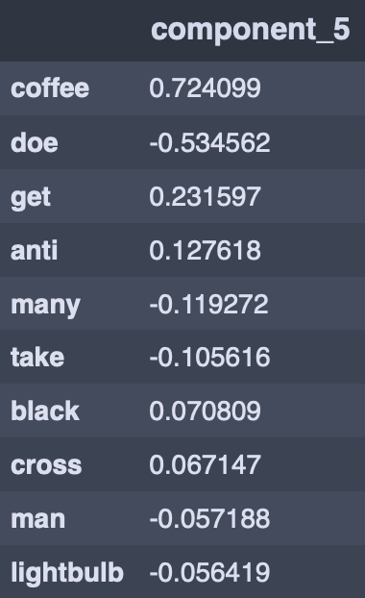
Step 4 Findings / Latent Semantic Analysis

Slide 14
Modeling and Conclusion
Baseline accuracy: ~50%
Using SVD features:
- KNN: 59%
Using SVD and word_count features:
- Random Forests: 64%
- Gradient Boosting: 65%

Slide 15
Recommended Actions
A joke and antijoke is sometimes difficult even for us to differentiate
Try different kind of topics in humor (jokes vs. non-joke)
Notes:
Admittedly, this was not as high a score that I wanted to achieve. However, I realize that finding the subtle difference between a Joke and an AntiJoke is something that even we as humans have difficulty explaining or understanding at times.
The 65% accuracy score tells me that there is definitely some signal that machine learning is picking up, which is a hopeful sign for future endeavors.

Slide 16
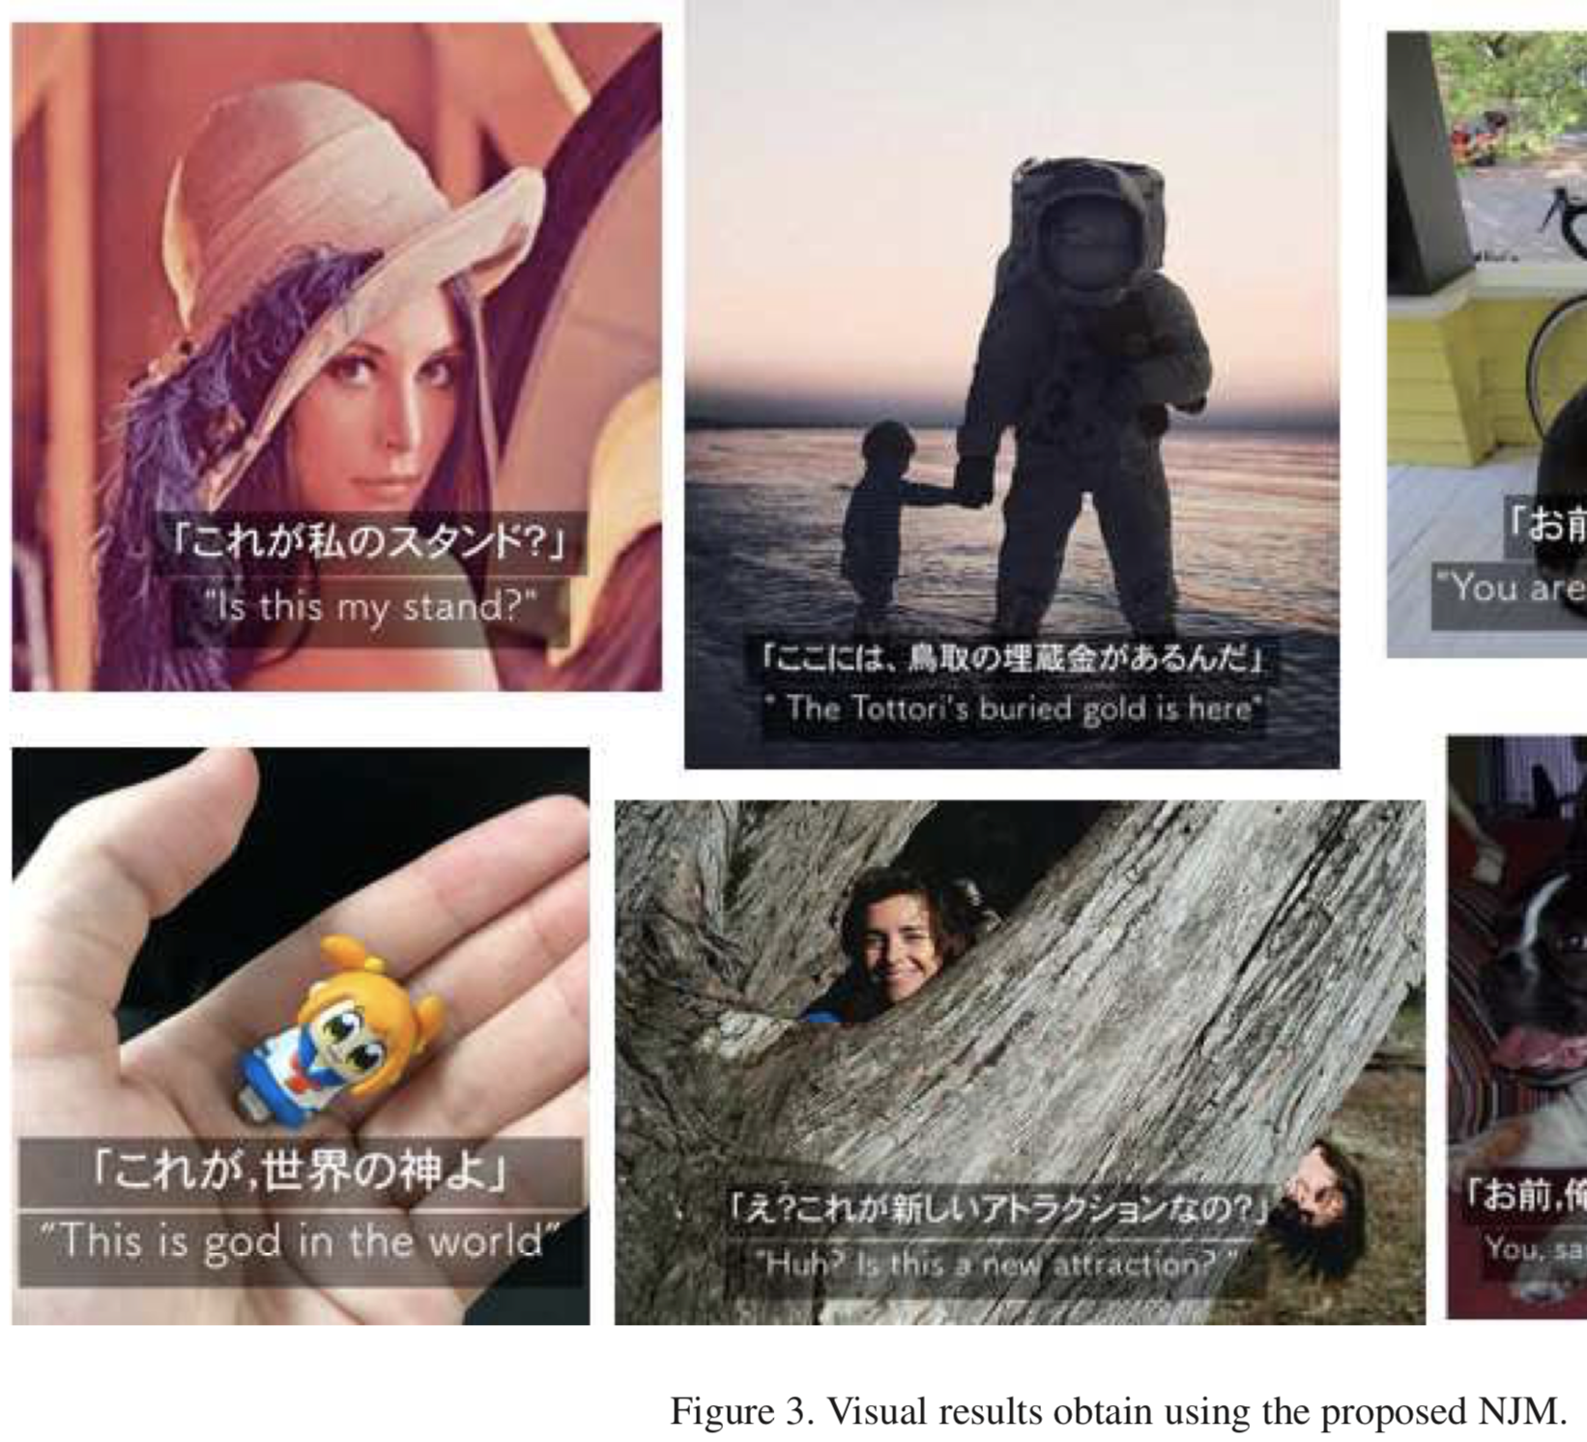
Next Steps / Questions
"Laughter is a special, higher-order function that only humans possess”
Years, maybe decades, before AI can understand humor as we do
Notes:
Future steps would be to become more well-versed in the academic literature concerning AI and humor, as well as looking more deeply into NLP as a whole.
Even so, making any machine that could have a decent stab at being funny would be a big step forward. "It's much better than the Turing test," says Williams. "With the Turing test, you've ended up having loads of teams coming up with canned rules to trick you."
With something like humor, he says, "you've really got to have a deep understanding of the world, how things work, how people work. It's indicative of something that really is intelligent.

